Slide 1
Databases
Lecture 3
SQL Basics. DML

Slide 2
STRUCTURED QUERY LANGUAGE (SQL)
Domain-specific language (Domain-specific language)
Used to work with relational databases
Managing a large amount of information with a single request
No need to specify how we get the record

Slide 3
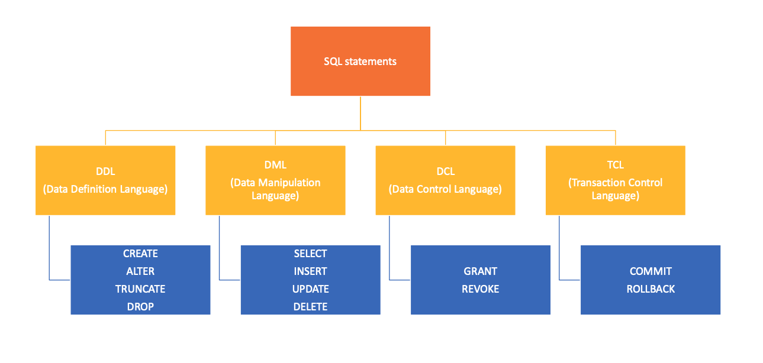
SQL Statements

Slide 4
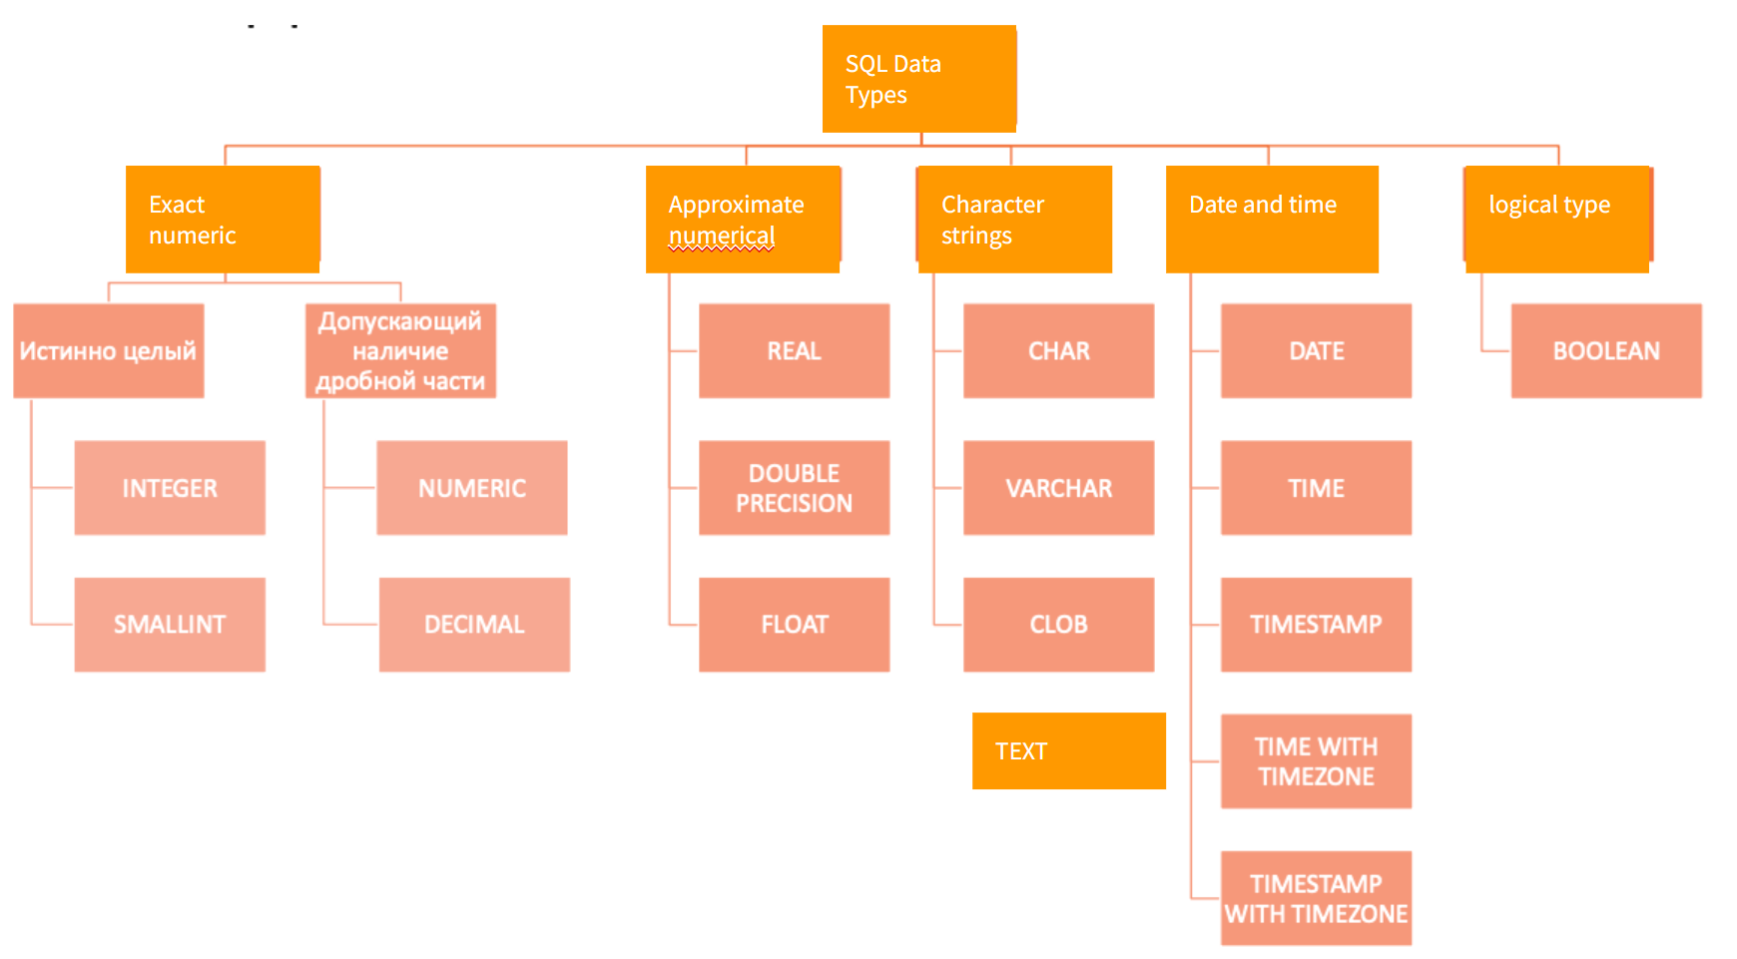
SQL Data Types

Slide 5
Data Definition Language
CREATE
CREATE [TEMPORARY] TABLE [IF NOT EXISTS] tbl_name(
col_name_1 datatype_1,
col_name_2 datatype_2,
...
col_name_N datatype_N
);

Slide 6
Create: restrictions
column name
CREATE TABLE students (
student_id int PRIMARY KEY,
first_name varchar(50),
last_name varchar(50),
age int NOT NULL,
email varchar(100)
);
column type
restriction

Slide 7
Restrictions
UNIQUE
CHECK
IS NOT NULL
PRIMARY/FOREIGN KEY
DEFAULT
…

Slide 8
Restrictions: PRIMARY KEY
PRIMARY KEY (primary key) is a field (or combination fields) that uniquely identifies the record.
PRIMARY KEY should:
- contain unique values
- cannot contain NULL values.

Slide 9
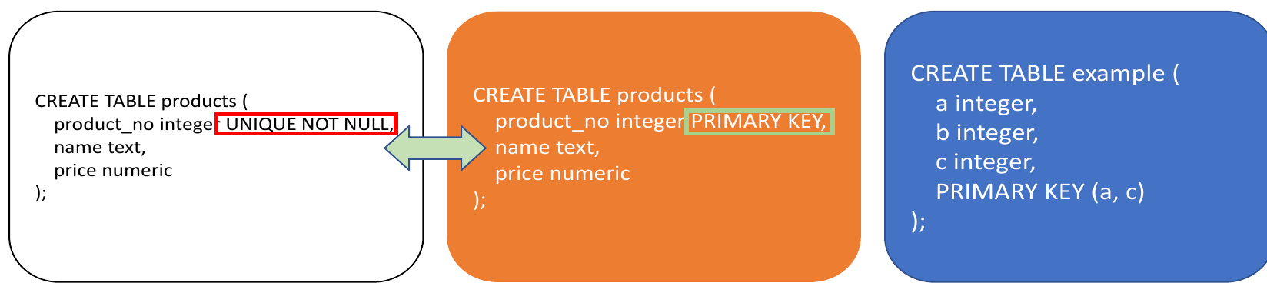
Restrictions: PRIMARY KEY
A table cannot have two records with the same key value.
A table can only have one primary key.

Slide 10
Restrictions: FOREIGN KEY
Foreign key - an attribute (or group of attributes) whose value can be repeated for several records.
Contains a reference to a primary key field in another table.
The table containing the foreign key is called a child table, containing the primary key - parent table.

Slide 11
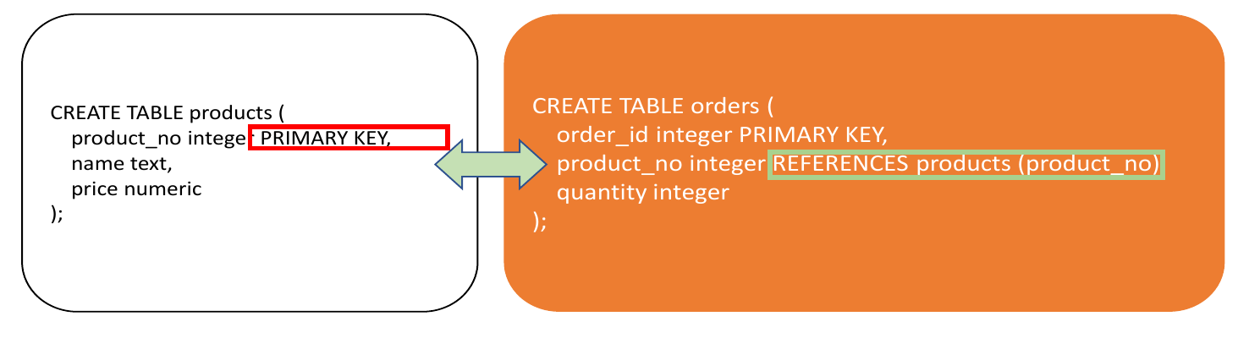
Restrictions: FOREIGN KEY

Slide 12
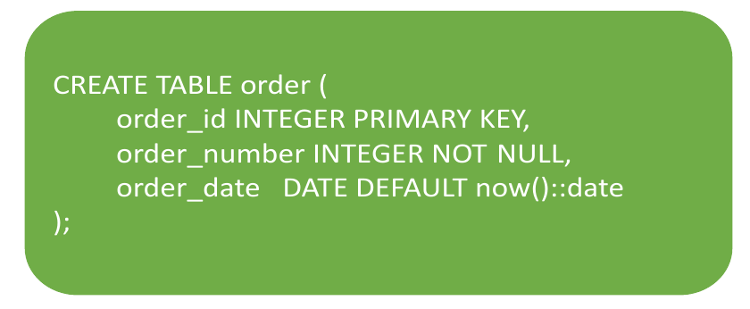
Restrictions: DEFAULT

Slide 13
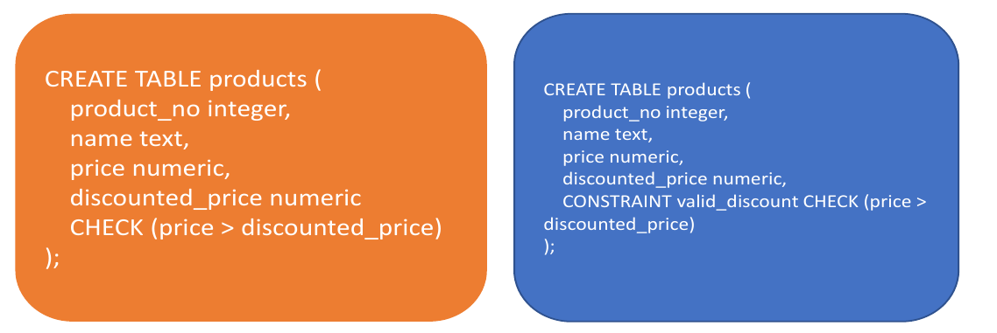
Restrictions syntax
Constraints can be named using the command CONSTRAINT (this is useful for error output)

Slide 14
Relations between tables
one to one
one to many
many to many

Slide 15
NULL value
A field with a NULL value is a field with no value.
If a field in a table is not required, then you can insert a new record or update without adding a value to the field; it will be stored as NULL.
A NULL value is different from a null value (0) or a field that contains spaces (" "). It is not possible to check for NULL values with comparison operators such as =, <, or <>.
You need to use IS NULL or IS NOT NULL

Slide 16
Restrictions: IS NULL / IS NOT NULL
IS NULL Syntax
SELECT column_names
FROM table_name
WHERE column_name IS NULL
IS NOT NULL Syntax
SELECT column_names
FROM table_name
WHERE column_name IS NOT NULL

Slide 17
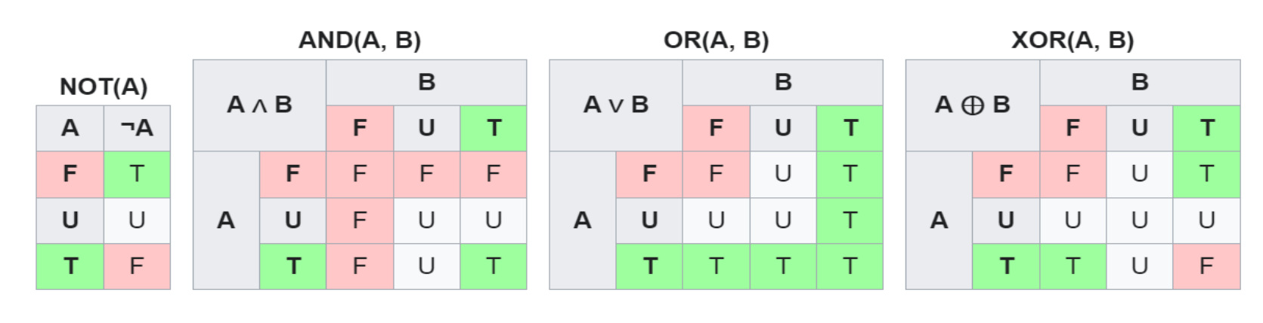
Ternary logic: True, False, Unknown

Slide 18
Data Definition Language
ALTER - modification of objects
ALTER TABLE table_name ADD column_name datatype;
ALTER TABLE table_name DROP column_name;
ALTER TABLE table_name RENAME column_name TO new_column_name;
ALTER TABLE table_name ALTER column_name TYPE datatype;

Slide 19

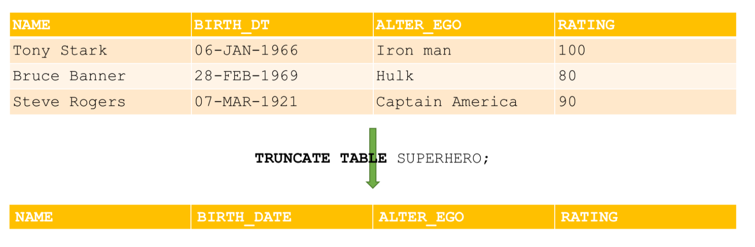
Data Definition Language
TRUNCATE – deleting the contents of the database object (data is deleted as a whole piece, cannot be deleted by condition)

Slide 20


Drop
Deleting an object from the database

Slide 21
Data Manipulation Language
SELECT
Selection of data that meets the specified conditions
INSERT
Adding new data
UPDATE
Change existing data
DELETE
Delete existing data

Slide 22
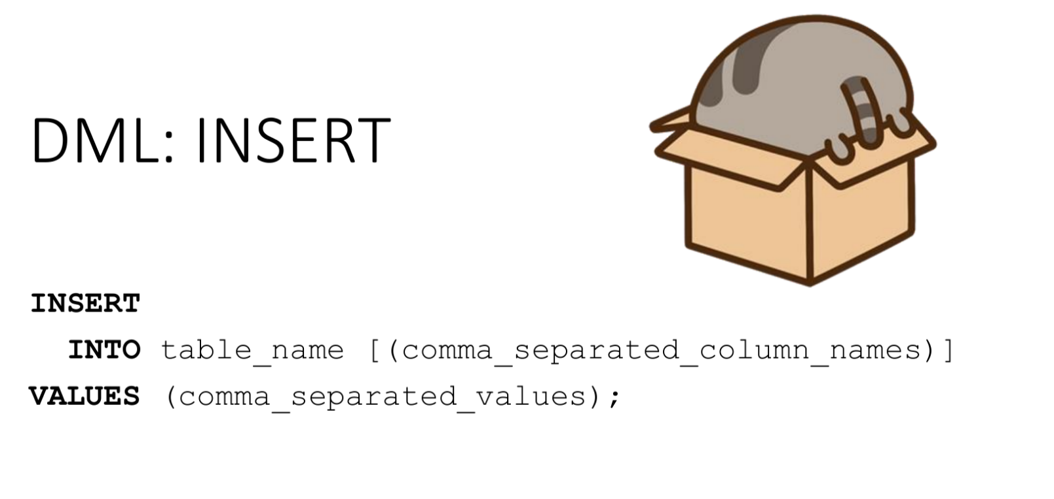

Slide 23
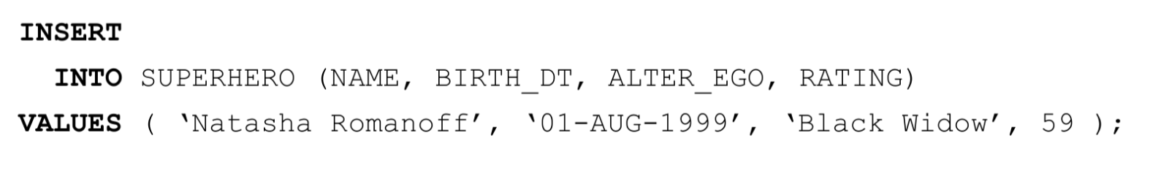
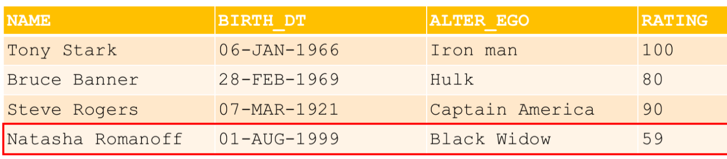
INSERT

Slide 24
INSERT: base syntax
INSERT INTO table_name [ ( column_name [, ...] ) ]
{ DEFAULT VALUES | VALUES ( { expression | DEFAULT } [, ...] ) [, ...] | request }
[ RETURNING * | result_expression [ [ AS ] result_name ] [, ...] ]

Slide 25
INSERT: syntax elements
table_name - the name of an existing table (possibly supplemented with a schema)
column_name - this column name can, if necessary, be supplemented with the name of a nested field or an index in the array
expression - the expression or value that will be assigned to the corresponding column
query - a query (SELECT statement) that will return rows to add to the table
result_expression is an expression that will be evaluated and returned by the INSERT command after each row is added or modified. This expression can use the names of any columns in the table_name table. To get all columns, just write *

Slide 26
INSERT: syntax elements
result_name - the name assigned to the returned column
Column names can be arranged in any order. The names of columns with default values can be omitted when enumerating or the DEFAULT parameter can be explicitly specified. If you do not specify a list of columns, but do not provide all the values for the columns in the insertion, then the insertion will occur sequentially in all “cells” of the row, and therefore the system will generate an error either due to a mismatch of data type, or due to insufficient data added to data string

Slide 27
INSERT: examples
CREATE TABLE example_table (
id SERIAL PRIMARY KEY,
name TEXT DEFAULT 'Unknown',
age INTEGER DEFAULT 18,
email TEXT DEFAULT 'example@example.com’
);
SELECT * FROM example_table;

Slide 28
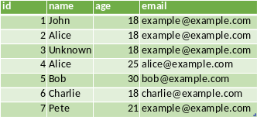
INSERT: examples
1) INSERT INTO example_table (name) VALUES ('John’);
2) INSERT INTO example_table (name, age) VALUES ('Alice', DEFAULT);
3) INSERT INTO example_table DEFAULT VALUES;
4) INSERT INTO example_table (name, age, email) VALUES
('Alice', 25, 'alice@example.com’),
('Bob', 30, 'bob@example.com’),
('Charlie', DEFAULT, 'charlie@example.com’);
5) INSERT INTO example_table (age, name) VALUES (12+7+2, 'Pete');

Slide 29

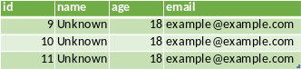
INSERT: examples
1) INSERT INTO example_table DEFAULT VALUES
RETURNING *;
2) INSERT INTO example_table (age) VALUES (DEFAULT), (DEFAULT), (DEFAULT)
RETURNING *;

Slide 30
INSERT + SELECT
INSERT INTO products (product_no, name, price)
SELECT product_no, name, price FROM new_products
WHERE release_date = 'today’;

Slide 31
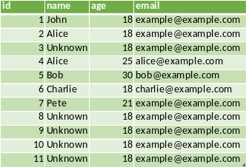
INSERT for table copying
CREATE TABLE example_table_2 (
id SERIAL PRIMARY KEY,
name TEXT DEFAULT 'Unknown',
age INTEGER DEFAULT 18,
email TEXT DEFAULT 'example@example.com'
);
INSERT INTO example_table_2 SELECT * FROM example_table;

Slide 32
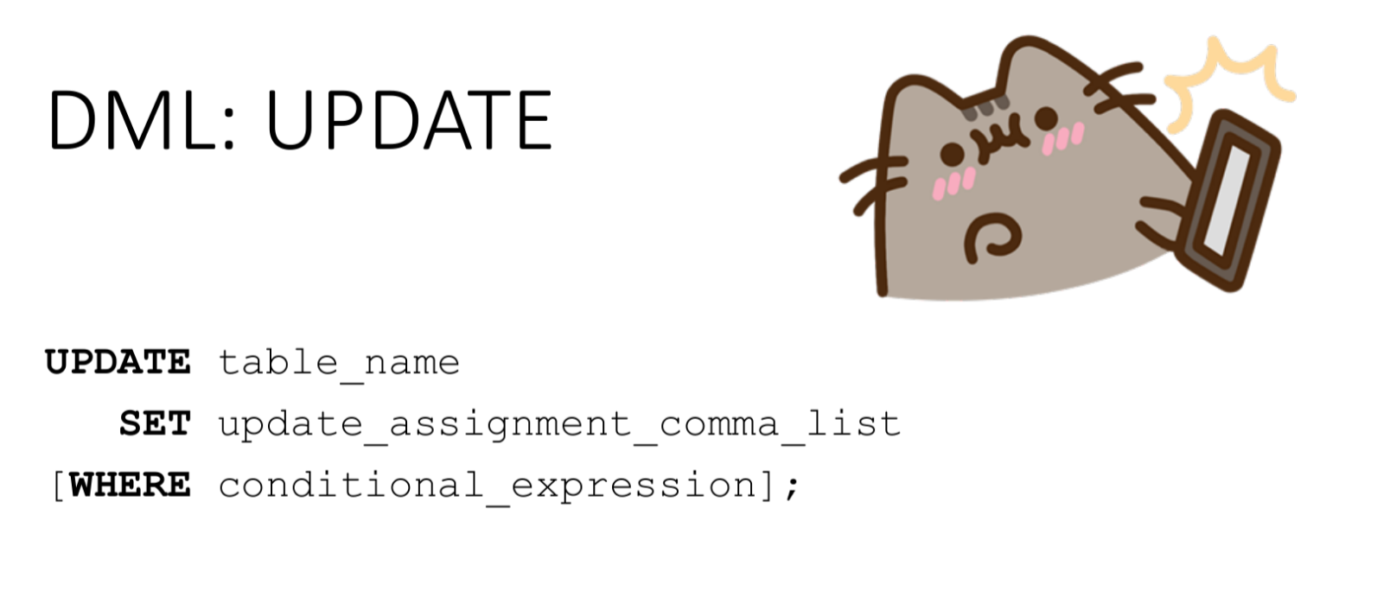

Slide 33

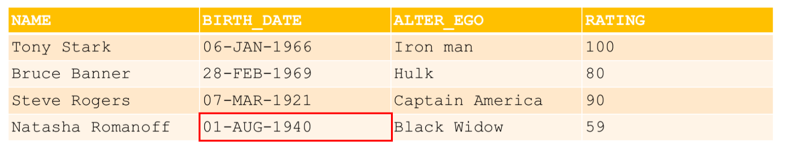
Update

Slide 34
UPDATE: syntax
UPDATE table_name [ * ]
SET { column_name = { expression | DEFAULT } |
( column_name [, ...] ) = ( nested_SELECT )
} [, ...]
[ FROM element_FROM [, ...] ]
[WHERE condition]
[ RETURNING * | result_expression [ [ AS ] result_name ] [, ...] ]

Slide 35
UPDATE: syntax
nested_SELECT is a subSELECT query that returns as many output columns as are listed in the parenthetical list of columns that precede it. This subquery should return a maximum of one row. If it produces a single row, the column values in it are assigned to the target columns; if it does not return a row, the target columns are assigned NULL. This subquery can access the previous values of the currently modified row in the table
element_FROM is a table expression that allows access to columns of other tables in the WHERE clause and new data expressions. It uses the same syntax as the FROM clause of the SELECT statement
condition - an expression that returns a boolean value. Only those stocks for which this expression returns true will be changed.

Slide 36
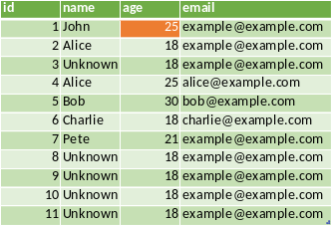
UPDATE: examples
UPDATE example_table
SET age = 25
WHERE id = 1;

Slide 37
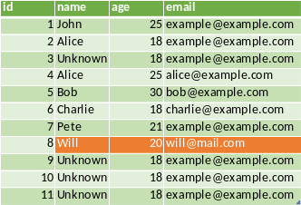
UPDATE: examples
UPDATE example_table
SET (age, name, email) = (20, ‘Will’, ‘will@mail.com’)
WHERE id = 8;

Slide 38
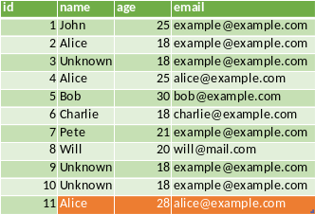
UPDATE: examples
UPDATE example_table
SET (age, name, email) = (
SELECT age+3, name, email
FROM example_table
WHERE id = 4
)
WHERE id = 11;

Slide 39
UPDATE: Example with FROM... WHERE
Changing the contact name in the account table (this should be the name of the assigned sales manager):
UPDATE accounts SET
contact_first_name = first_name,
contact_last_name = last_name
FROM employees
WHERE employees.id = accounts.sales_person;

Slide 40


Slide 41

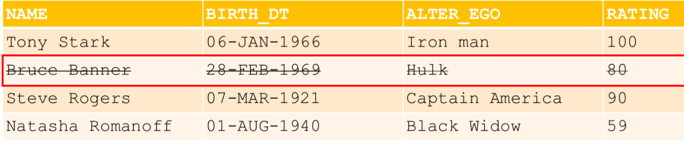
Delete

Slide 42
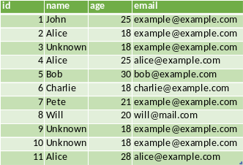
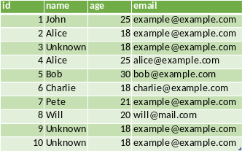
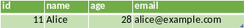
DELETE: example
DELETE FROM example_table_2
WHERE id = 11
RETURNING *

Slide 43
DELETE vs TRUNCATE vs DROP
DELETE | TRUNCATE | DROP
"Delete" line by line | Deleting the entire block at once | Deleting the entire table
You can set conditions for deletion | Conditions for deletion cannot be set | Conditions for deletion cannot be set
Ability to roll back changes | There is no possibility of rolling back changes | There is no possibility of rolling back changes
Physically, the lines are not deleted, only marked "invisible" from a certain moment VACUUM is needed for removal | Deleting data and freeing up disk space occurs immediately | Deleting data and freeing up disk space occurs immediately

Slide 44
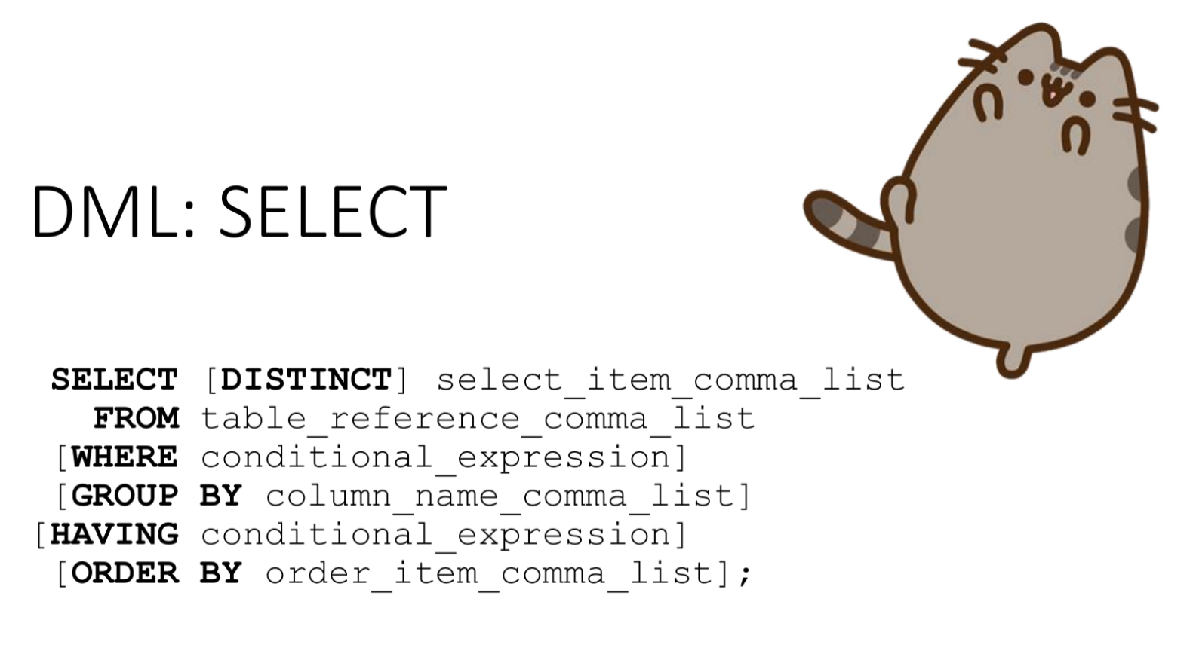

Slide 45
SELECT: syntax
SELECT [ ALL | DISTINCT [ ON ( expression [, ...] ) ] ]
[ * | expression [ [ AS ] result_name ] [, ...] ]
[ FROM element_FROM [, ...] ]
[WHERE condition]
[ GROUP BY group_item [, ...] ]
[HAVING condition]
[ { UNION | INTERSECT | EXCEPT } selection ]
[ ORDER BY expression [ ASC | [, ...] ]
[ LIMIT { number | ALL } ]
[ OFFSET start [ ROW | ROWS ] ]
list of samples
table expression
sorting

Slide 46
SELECT syntax
SELECT returns a set consisting of at least one value. For simplicity at this point, consider that SELECT always returns a table that has at least one row with at least one cell. In the latter case, SELECT is also said to return a scalar value.
The select list specifies the columns that will appear in the resulting relation. It is also possible to specify an operation on each column value. The syntax for column references is variable:
SELECT a, b, c FROM ...
SELECT tbl1.a, tbl2.a, tbl1.b FROM ...
SELECT tbl1.*, tbl2.a FROM ...

Slide 47
SELECT syntax
In the selection list, you can assign “aliases” to the columns of the resulting table:
SELECT a AS value, b + c AS sum FROM ...
The word AS can usually be omitted, but in some cases, when the desired column name is the same as a PostgreSQL keyword, you need to write AS or enclose the column name in quotes to avoid ambiguity.
A similar rule applies to tables listed after the FROM clause, but:
the alias becomes the new table name within the current query, i.e., after assigning an alias, the original table name cannot be used elsewhere in the query
they are necessary when a table is joined to itself

Slide 48
SELECT syntax
The result of evaluating a table expression is a (virtual) table, which can also consist of just one cell (scalar)
You can omit the table expression and use SELECT to return the result of the expression evaluation: SELECT 3*4; SELECT 5!=4;
The FROM clause creates a table from one or more table references, separated by commas:
FROM table1 [, table_2, …, table_N]
A table reference (table_N in the example) could be:
table name (possibly with schema name),
derived table, for example:
subquery
joining tables
a complex combination of these options.
If multiple references are listed in the FROM clause, a cross join is applied to them as the result of the Cartesian product of the relations

Slide 49
SELECT syntax
The basic syntax for joining tables is as follows:
T1 connection_type T2 [ connection_condition ]
Junctions of any type can be nested or combined: both T1 and T2 can be the results of a join
Connection types in PostgreSQL:
CROSS JOIN
String matching joins:
INNER JOIN
LEFT OUTER JOIN
RIGHT OUTER JOIN
FULL OUTER JOIN

Slide 50
SELECT: JOINs
T1 { [INNER] | {LEFT | RIGHT | FULL } [OUTER] } JOIN T2
ON boolean_expression
T1 { [INNER] | {LEFT | RIGHT | FULL } [OUTER] } JOIN T2
USING (join column list)
T1 NATURAL { [INNER] | {LEFT | RIGHT | FULL } [OUTER] } JOIN T2

Slide 51
SELECT: JOINs
The words INNER and OUTER are optional in all forms. By default, an INNER is assumed, and when LEFT, RIGHT and FULL are specified, an outer join is assumed.
The join condition is specified in the ON or USING clause, or is implicitly specified by the NATURAL keyword. This condition determines which rows of the two source tables are considered to "match" each other (this is discussed in detail below).

Slide 52
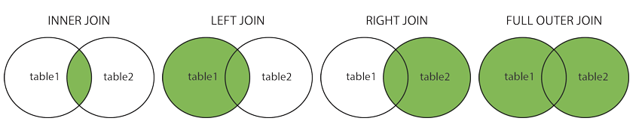
JOIN

Slide 53
CROSS JOIN
CROSS JOIN = Cartesian product of two tables
SELECT column_name(s) FROM table1 CROSS JOIN table2

Slide 54
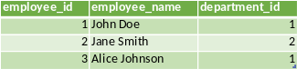
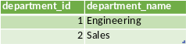
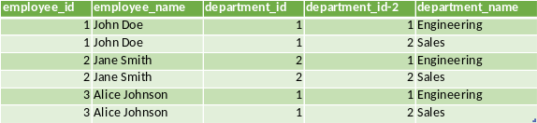
CROSS JOIN
SELECT * FROM employees CROSS JOIN departments;

Slide 55
CROSS JOIN
SELECT * FROM employees CROSS JOIN departments;
SELECT * FROM employees INNER JOIN departments ON TRUE;

Slide 56
INNER JOIN
INNER JOIN: Returns records that have matching values in both tables
INNER JOIN Syntax
SELECT column_name(s) FROM table1 INNER JOIN table2 ON table1.column_name = table2.column_name

Slide 57
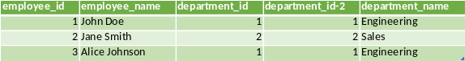
INNER JOIN
SELECT *
FROM employees e
INNER JOIN departments d
ON e.department_id =d.department_id;

Slide 58
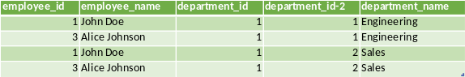
INNER JOIN
SELECT *
FROM employees e
INNER JOIN departments d
ON e.department_id = 1;

Slide 59
INNER JOIN
SELECT *
FROM employees e
INNER JOIN departments d
ON e.department_id = d.department_id
AND e.department_id = 1;

Slide 60
LEFT JOIN
LEFT (OUTER) JOIN: Returns all records from the left table and matching records from the table on the right
LEFT JOIN Syntax
SELECT column_name(s) FROM table1 LEFT JOIN table2 ON table1.column_name = table2.column_name;

Slide 61
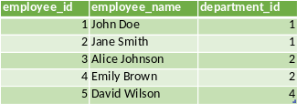
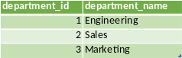
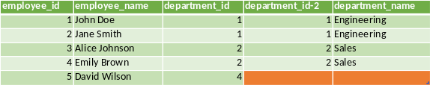
LEFT JOIN
SELECT * FROM employees
LEFT JOIN departments
ON employees.department_id =
departments.department_id;

Slide 62
RIGHT JOIN
RIGHT (OUTER) JOIN: Returns all records from the table on the right, and matching records from the left table
RIGHT JOIN Syntax
SELECT column_name(s) FROM table1 RIGHT JOIN table2 ON table1.column_name = table2.column_name;

Slide 63
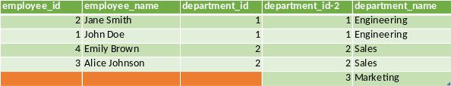
RIGHT JOIN
SELECT * FROM employees
RIGHT JOIN departments
ON employees.department_id =
departments.department_id;

Slide 64
FULL JOIN
FULL (OUTER) JOIN: Returns all records when there is a match in the left or right table
FULL OUTER JOIN Syntax
SELECT column_name(s) FROM table1 FULL OUTER JOIN table2 ON table1.column_name = table2.column_name;

Slide 65
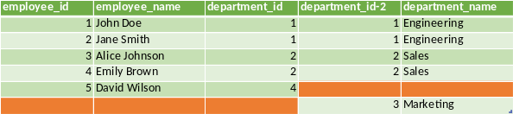
FULL JOIN
SELECT * FROM
employees
FULL JOIN departments
ON employees.department_id =
departments.department_id;

Slide 66
SELECT syntax: WHERE
WHERE constraint_condition
constraint_condition - any value expression that produces a boolean result
SELECT ... FROM fdt WHERE c1 > 5
SELECT ... FROM fdt WHERE c1 IN (1, 2, 3)
SELECT ... FROM fdt WHERE c1 IN (SELECT c1 FROM t2)

Slide 67
SELECT syntax: GROUP BY + HAVING
SELECT selection_list
FROM...
[WHERE...]
GROUP BY group_item [, group_item ]...
HAVING boolean_expression

Slide 68
SELECT syntax: GROUP BY + HAVING
In the SQL standard, GROUP BY can only group by columns of the source table, but the PostgreSQL extension allows you to use GROUP BY more flexibly. The GROUP BY clause collects into one row all selected rows that produce the same values for the grouping expressions. The expression inside the group_element can be the name of the input column, or the name or sequence number of the output column (from the list of SELECT elements), or an arbitrary value calculated from the values of the input columns. In case of ambiguity, the name in GROUP BY will be treated as the name of the input column, not the output column

Slide 69
SELECT syntax: GROUP BY + HAVING
Aggregate functions, when used, are evaluated over all rows that make up each group and ultimately produce a separate value for each group
When a GROUP BY clause or any aggregate function is present in a query, expressions in the SELECT list generally cannot access non-groupable columns because otherwise the non-groupable column would have to return more than one possible value
If the table has been grouped using GROUP BY, but only some of the groups are of interest, you can filter them using the HAVING clause, which acts similar to WHERE

Slide 70
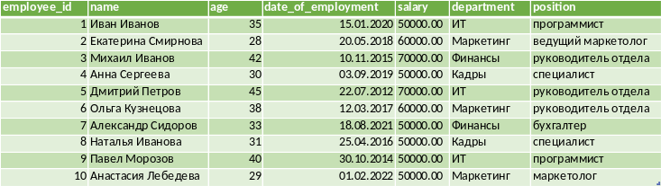
SELECT syntax: GROUP BY + HAVING
SELECT department FROM new_employees GROUP BY department;
SELECT salary FROM new_employees GROUP BY salary;

Slide 71
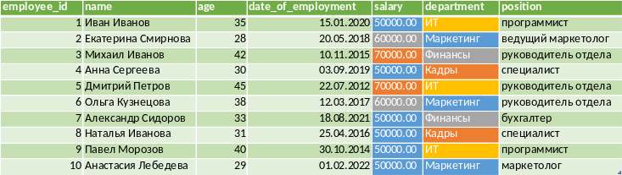
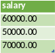
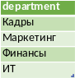
SELECT syntax: GROUP BY + HAVING
SELECT department FROM new_employees GROUP BY department;
SELECT salary FROM new_employees GROUP BY salary;

Slide 72
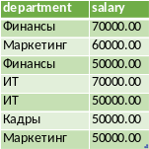
SELECT syntax: GROUP BY + HAVING
SELECT department, salary
FROM new_employees
GROUP BY
salary
department;
The order in which the columns are listed does not affect the result!

Slide 73
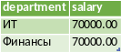
SELECT syntax: GROUP BY + HAVING
SELECT department, salary
FROM new_employees
GROUP BY
salary,
department
HAVING salary> 60000;

Slide 74
SELECT syntax: SORT
The syntax for a sort expression is as follows:
SELECT selection_list
FROM table_expression
ORDER BY sort_expression1 [ASC | DESC] [NULLS { FIRST | LAST }]
[, sort_expression2 [ASC | DESC] [NULLS { FIRST | LAST }] ...]
Sort expressions can be any expressions allowed in the query's select list

Slide 75
SELECT syntax: SORT
When multiple expressions are specified, subsequent values allow you to sort rows that match all previous values. Each expression can be supplemented with the keywords ASC or DESC, which select sorting in ascending or descending order, respectively. The default is ascending order (ASC)
To determine the location of NULL values, you can use the NULLS FIRST and NULLS LAST hints, which place NULL values before or after non-NULL values, respectively. By default, NULL values are considered to be greater than any other, that is, NULLS FIRST is assumed for DESC order and NULLS LAST otherwise

Slide 76
SQL: query order
SQL is a declarative language, in which you describe what you want to achieve, not how to do it
SQL is a semantically redundant language!
Although the language developers tried to reduce the entry threshold for beginners working with SQL as much as possible, SQL queries are not trivial
The process or command of obtaining data from a database is called a query. In SQL, queries are formulated using the SELECT command
Let's understand how a SELECT query works

Slide 77
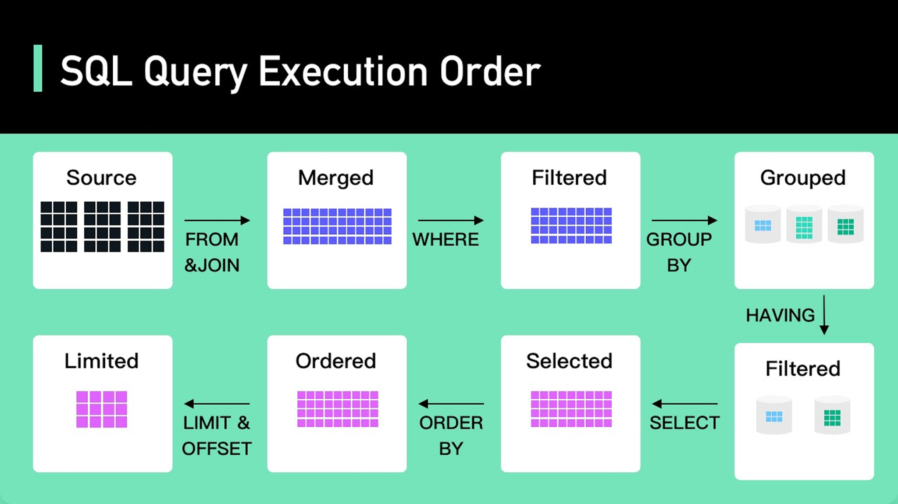
The order of execution of the request
FROM & JOIN
WHERE
GROUP BY
HAVING
SELECT
ORDER BY
LIMIT & OFFSET

Slide 78
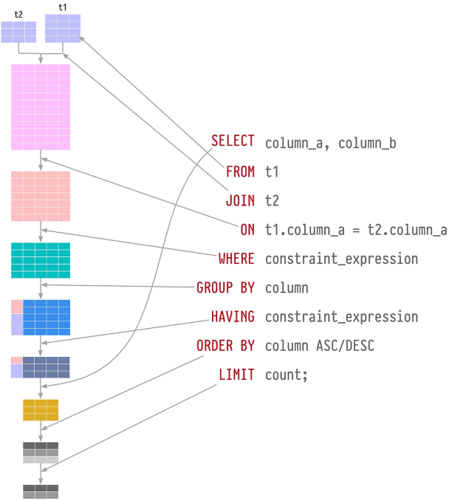

Slide 79
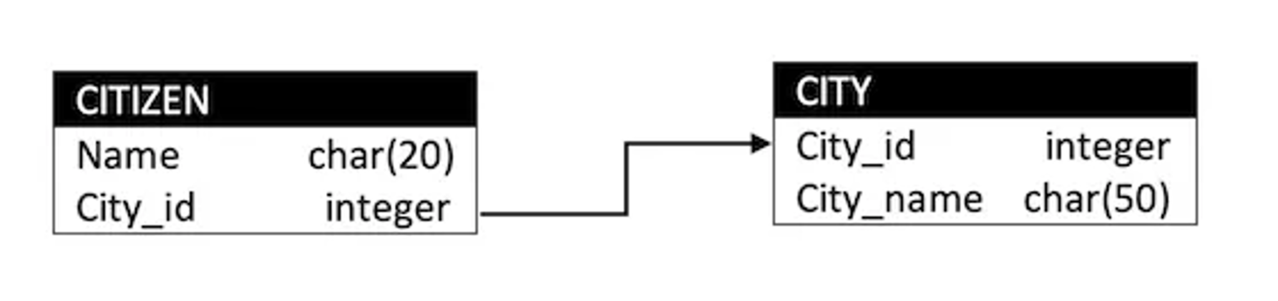
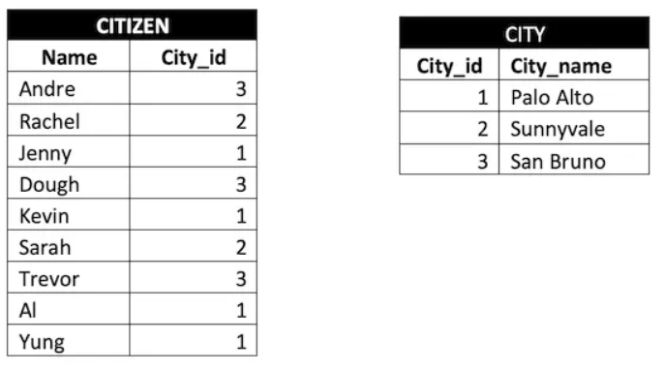
SELECT example
We want to know the name of only two cities other than San Bruno that have two or more residents.
We also want to get the result sorted alphabetically

Slide 80
SELECT example
We want to know the name of only two cities other than San Bruno that have two or more residents.
We also want to get the result sorted alphabetically

Slide 81
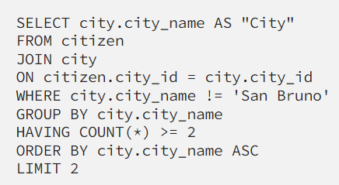
SELECT example

Slide 82
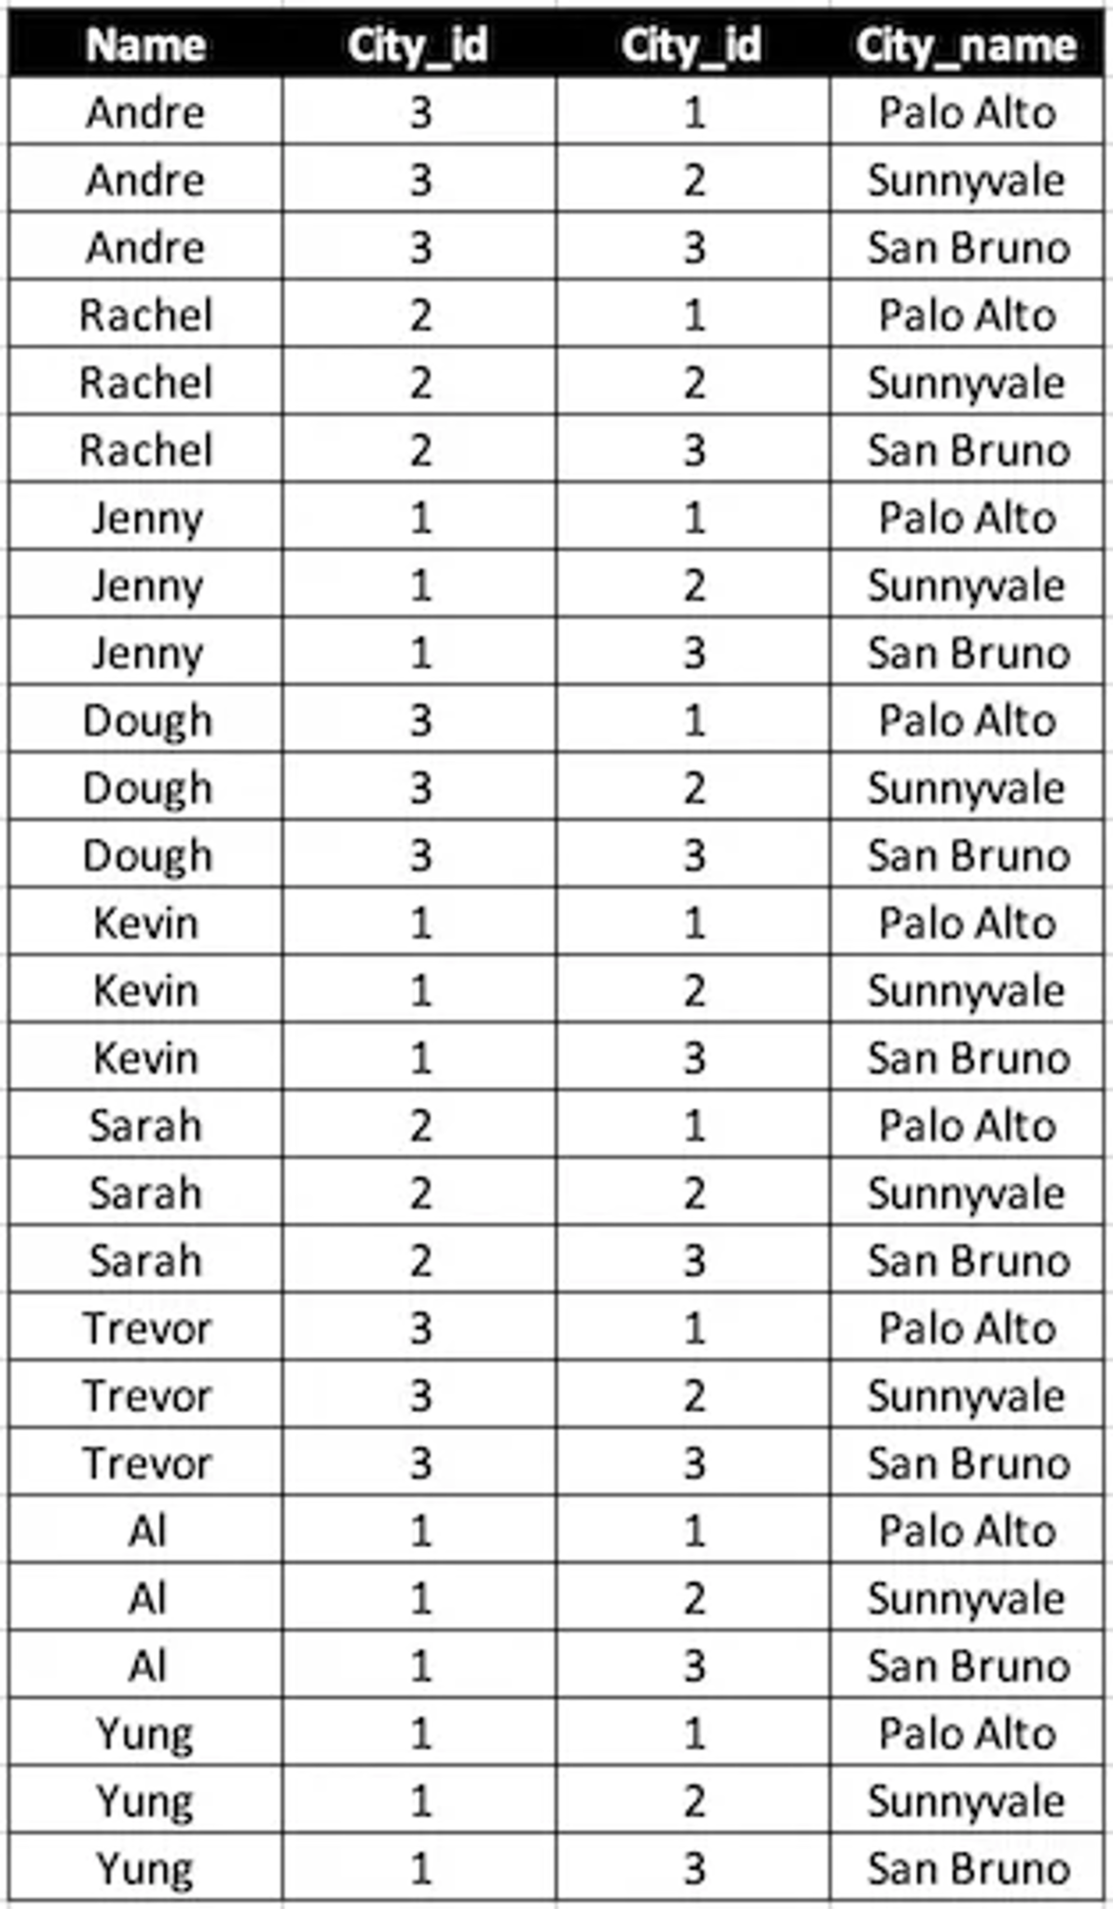
SELECT example

Slide 83
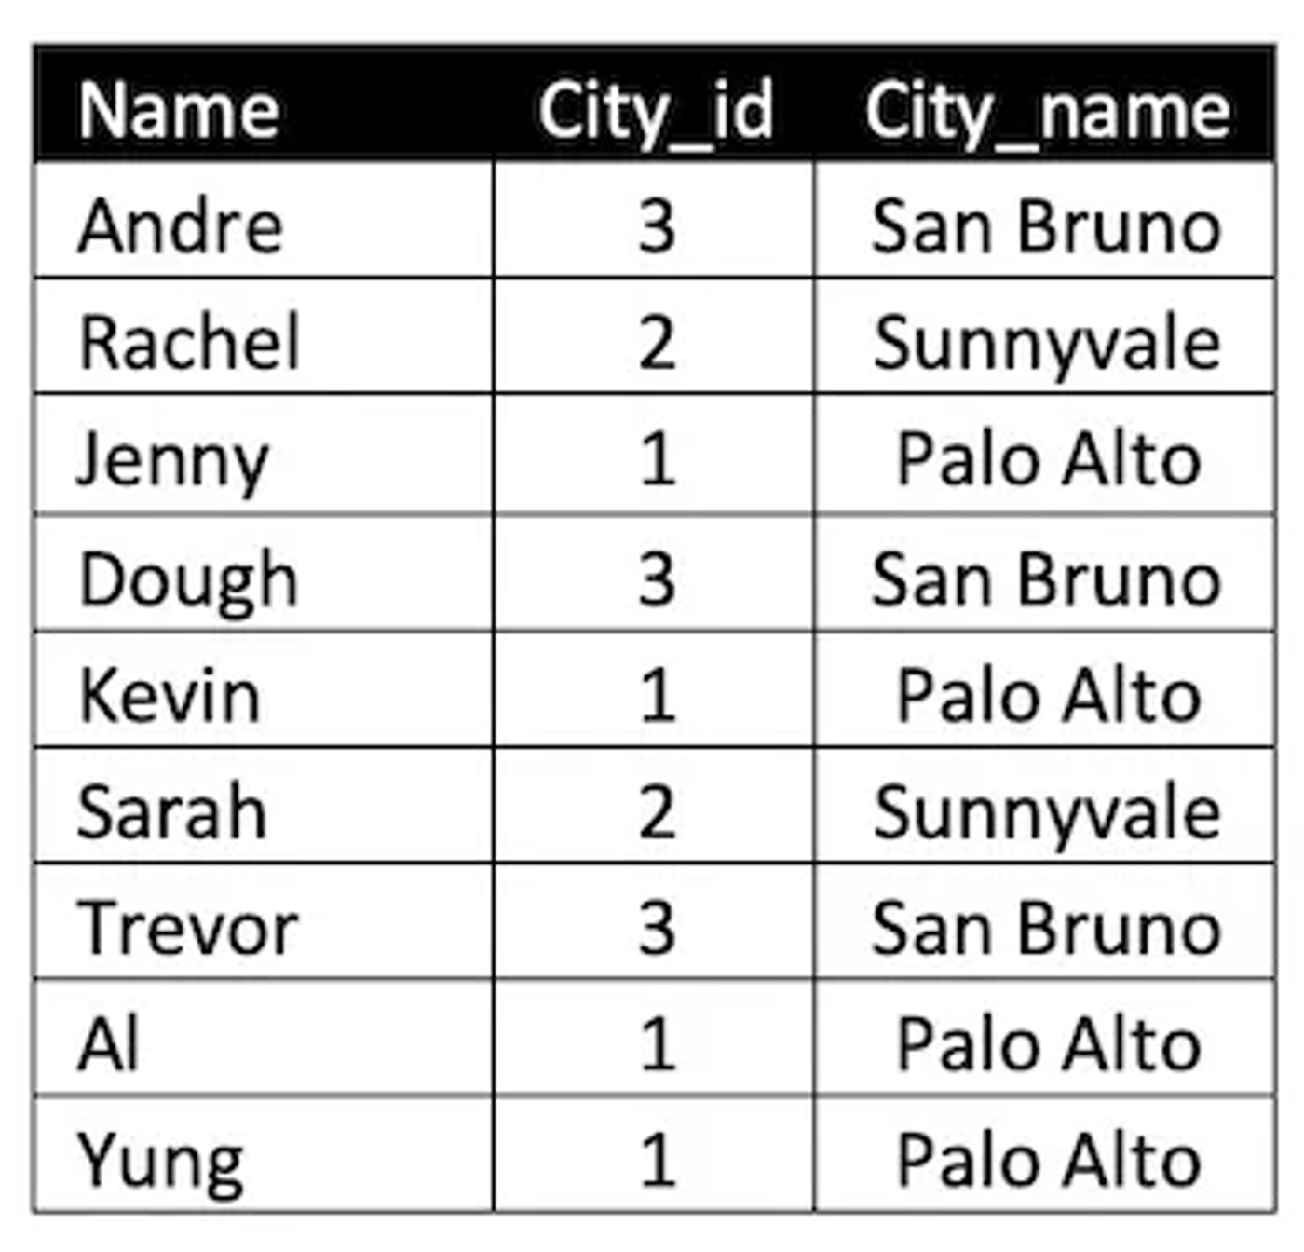
SELECT example

Slide 84
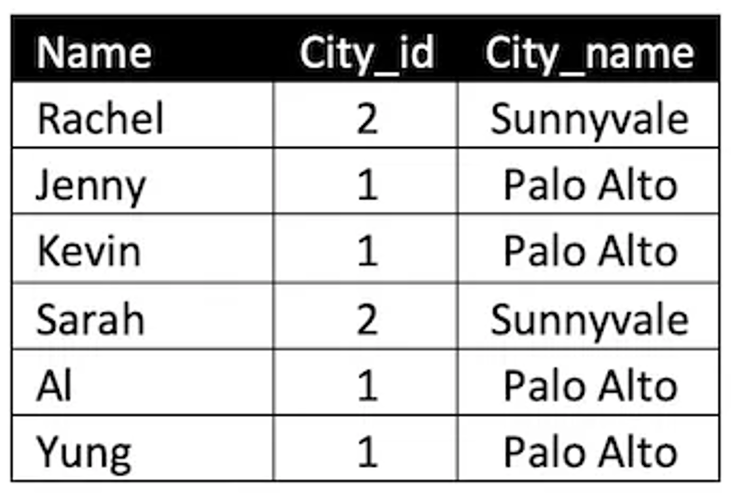
SELECT example

Slide 85
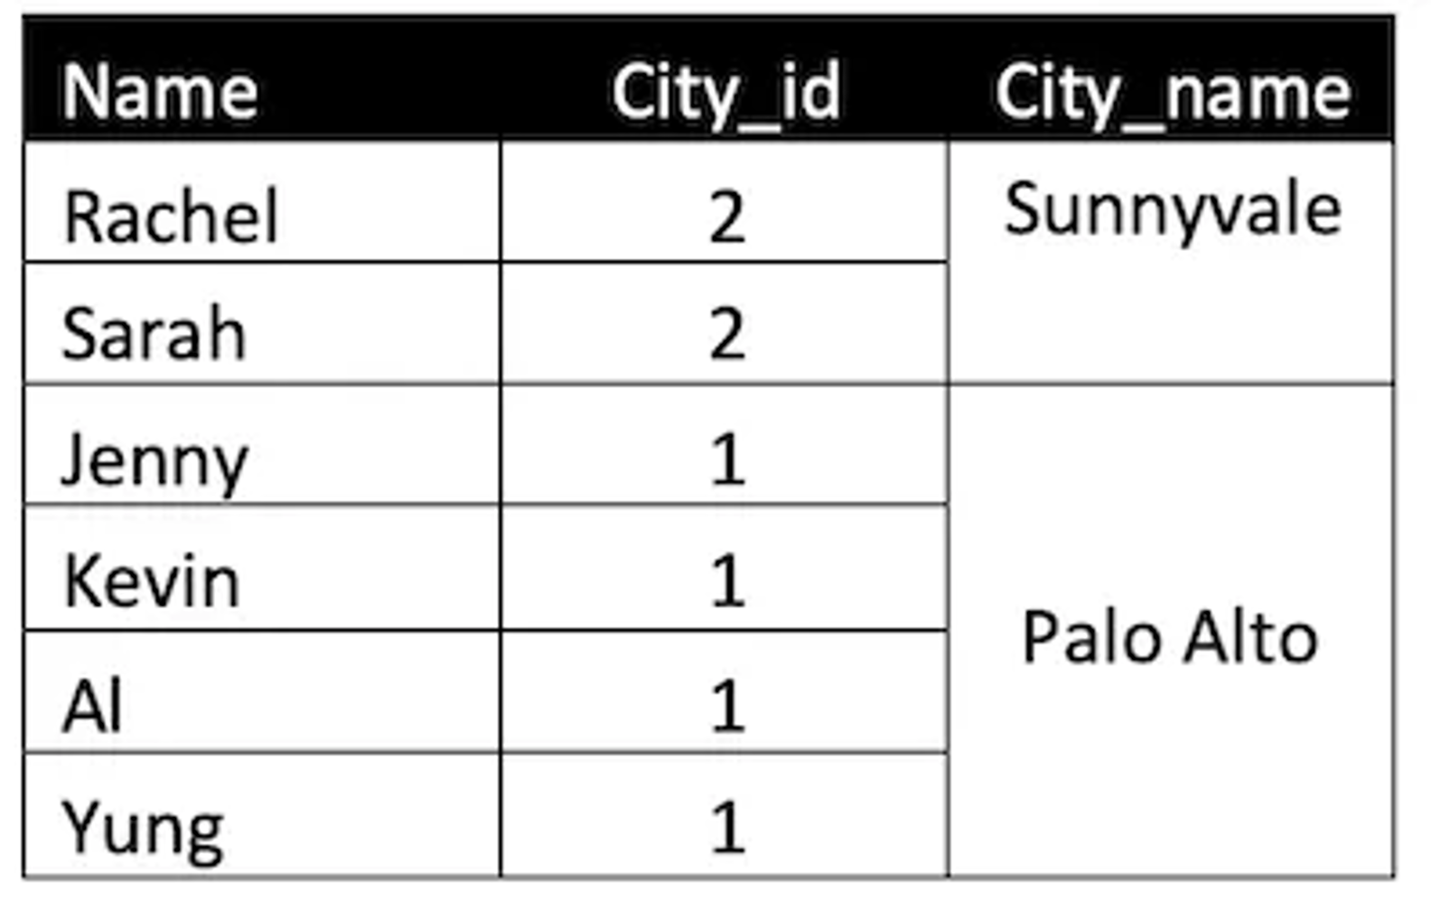
SELECT example

Slide 86
SELECT example

Slide 87

SELECT example

Slide 88

SELECT example

Slide 89
Aggregating functions
count() – the number of records with a known value. If you need to count the number of unique values, you can use count(DISTINCT field_nm)
max() - the largest of all selected field values (!= NULL)
min() - the smallest of all selected field values (!= NULL)
sum() - sum of all selected field values (!= NULL)
avg() - average of all selected field values (!= NULL)

Slide 90

Count
SELECT count(*) as total_rows
FROM new_employees;

Slide 91

Sum
SELECT sum(salary) as total_payments
FROM new_employees;

Slide 92

Max
SELECT max(date_of_employment) AS last_emploee
FROM new_employees;

Slide 93

Min
SELECT min(date_of_employment) AS first_emploee
FROM new_employees;

Slide 94

Avg
SELECT avg(salary) as
salary_average
FROM new_employees;

